Slide 1
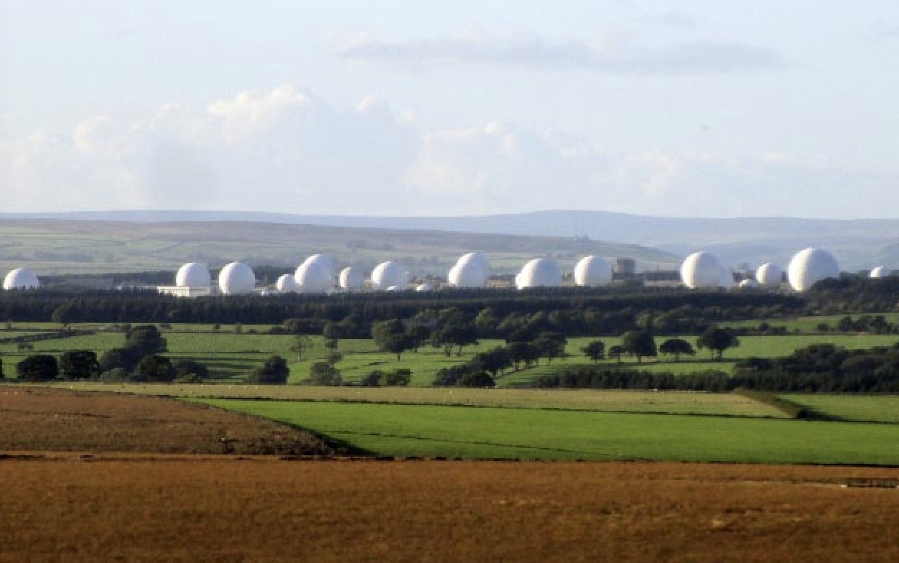
Why be concerned about accountability at Menwith Hill?

Slide 2
Accountability
Several definitions.
Key elements are: Responsibility Control Governance
Trust
the fact of being responsible for what you do and able to give a satisfactory reason for it, or the degree to which this happens:

Slide 3
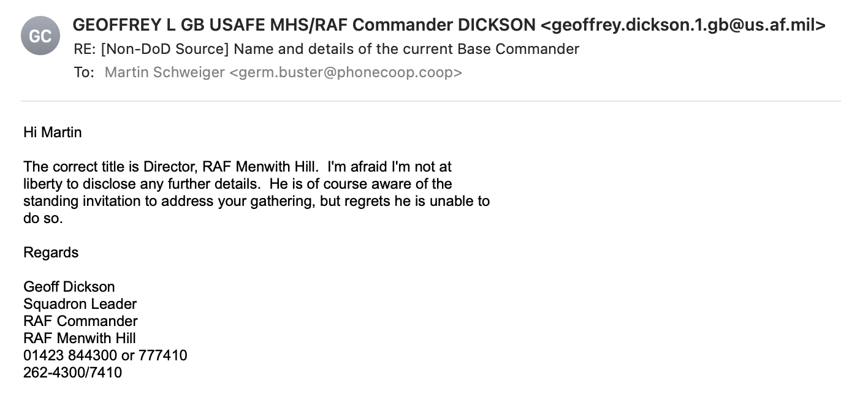

Slide 4
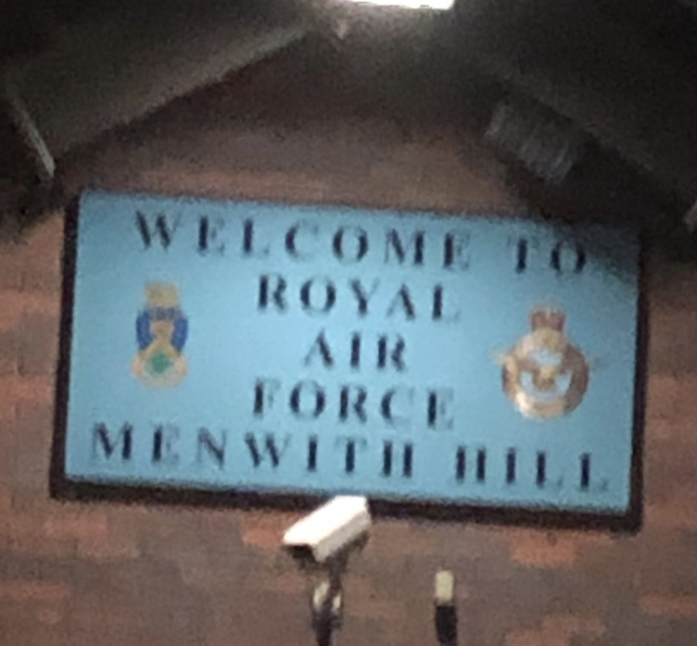
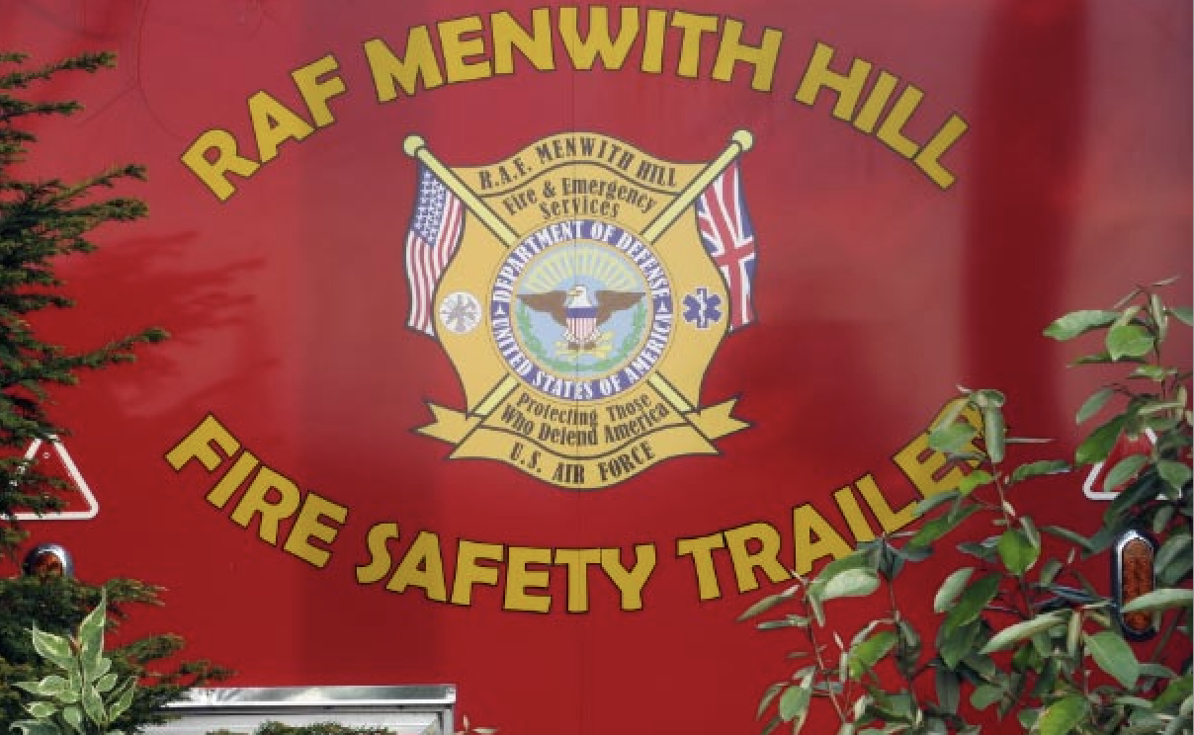
Name over the door
RAF Menwith Hill is actually controlled by
the US National Security Agency (NSA) and the
US National Reconnaissance Office (NRO)

Slide 5
What is at Menwith Hill?
Part of a national and international network of US military bases that exercise varying degrees of local and international control.
A communications base with multiple systems in use.
Multiple links to surveillance satellites and to ground based telecommunication systems.
Able and capable of processing large volumes of data.
Not under the control of the UK Government.

Slide 6
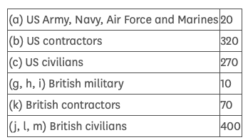
Who is at Menwith Hill?
American military service personnel
American civilian personnel
Small number of GCHQ staff
Small number of RAF personnel.
UK civilian personnel, mostly providing services.
UK MoD Police
Parliamentary answer in January 2021

Slide 7
Unseen players
US Government
The US military / industrial complex
Manufacturers of high tech communications equipment
?? UK Government – a very small voice!

Slide 8
Static or dynamic?
The base has steadily expanded since it was set up in the 1950s and is currently undergoing a substantial infrastructure upgrade.
Not only the physical structures are being changed and upgraded but the number and nature of the systems being operated are also continuing to evolve.

Slide 9
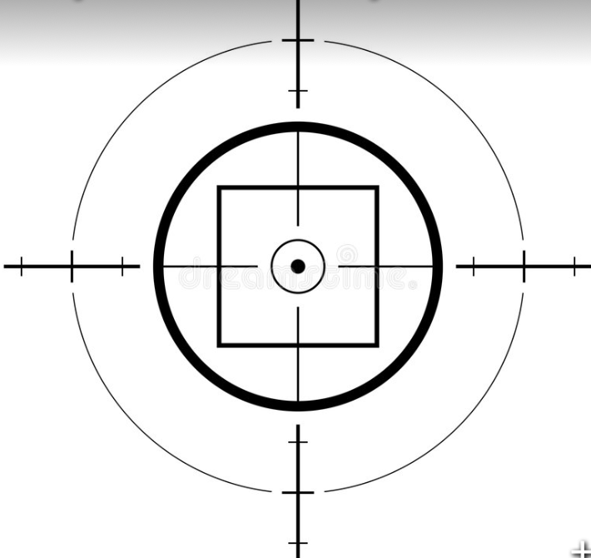
What sort of activity is undertaken at Menwith Hill?
There is no published definitive list.
We do know something about:
Involvement with targeting drones.
Involvement with the US Missile Defense System
Industrial, commercial, diplomatic and military surveillance
Data processing

Slide 10
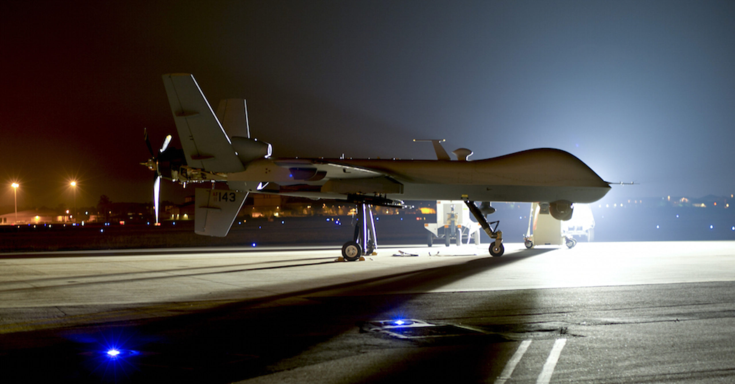
Armed drones
US Drone Strike Statistics 2004-2018 Minimum Confirmed Strikes: 4,809
Total Killed: 7,584 – 10,918
Civilians Killed: 751 – 1,555
Children Killed: 252 - 345
Total of US actions and resulting deaths in Pakistan, Afghanistan, Somalia, Yemen from the Bureau of Investigative Journalism
Notes:
This is a gross underestimate of U.S. drone killings because the BIJ only began counting drone deaths in Afghanistan in 2015. There are also no comprehensive tallies of drone killings in Iraq, Syria or Libya, nations where the U.S. has been conducting extensive drone attack operations. U.S. drones have also attacked in the Philippines.

Slide 11
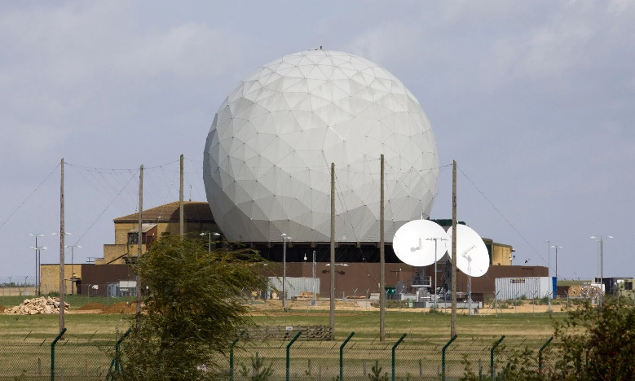
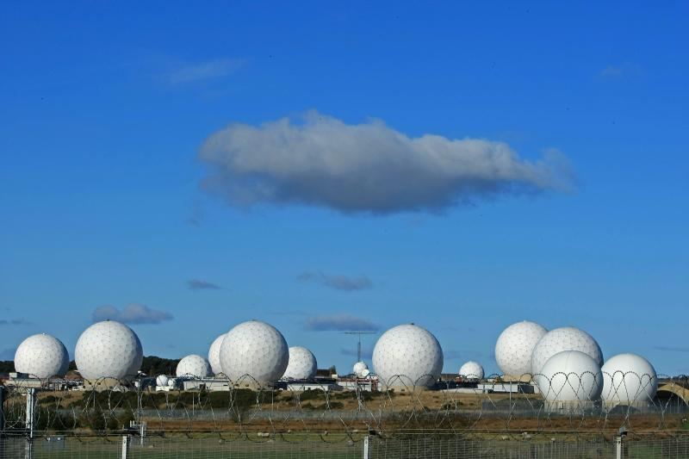
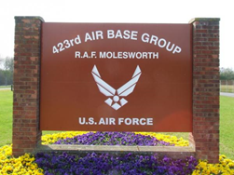
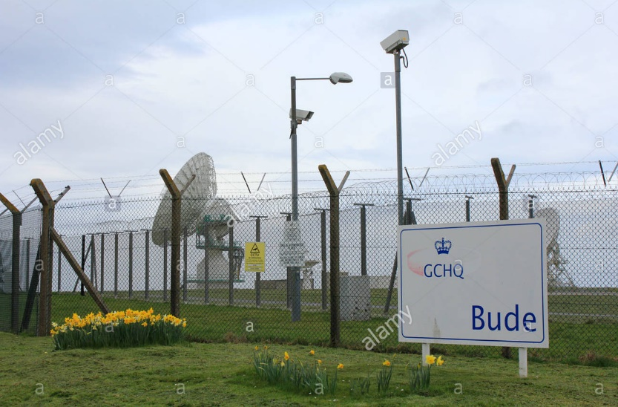
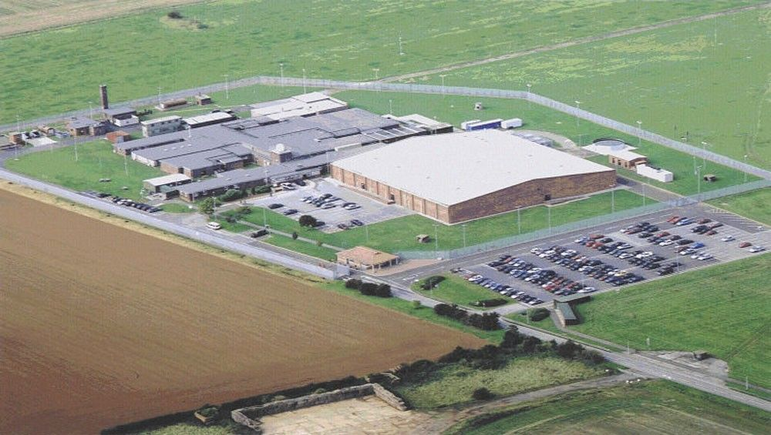
UK Cooperation
USAF Croughton, Menwith Hill, Molesworth, Bude and Digby, provide critical support to the US lethal drone programme & the
surveillance and intelligence operations that support it.

Slide 12
Who pays?
US government
US Commercial interests
UK pays for use of NHS, education and other services.
US personnel do not pay UK income tax.

Slide 13
Consequences of Menwith Hill?
Target for hostile acts.
Illegal actions taken from UK soil with no UK Govt involvement. Most such acts unlikely to be publicly reported.

Slide 14
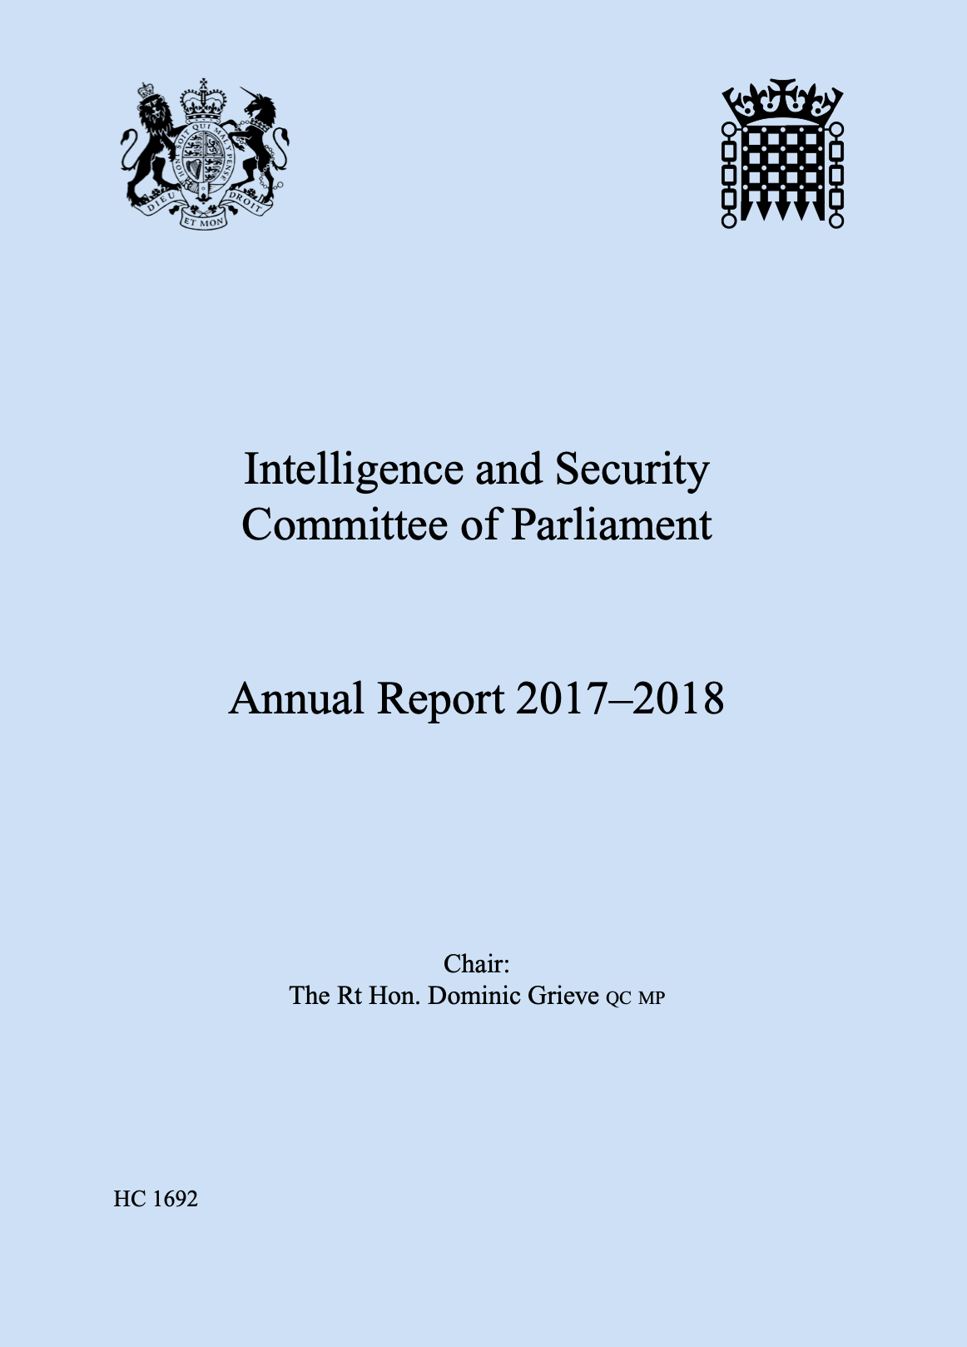
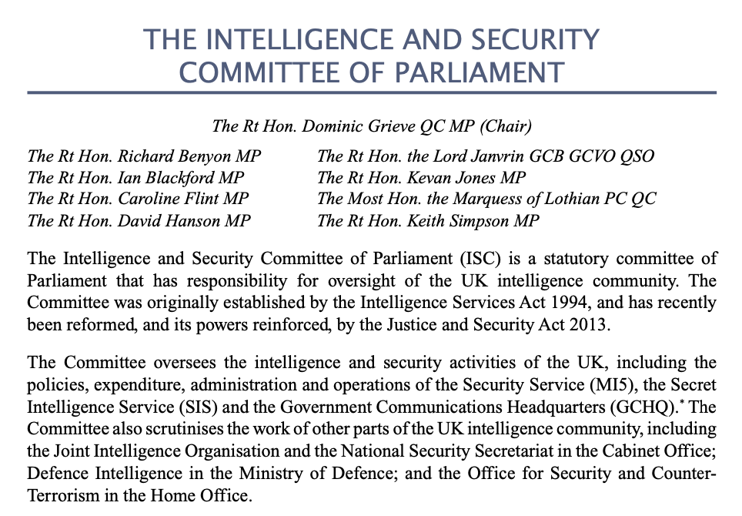

Slide 15
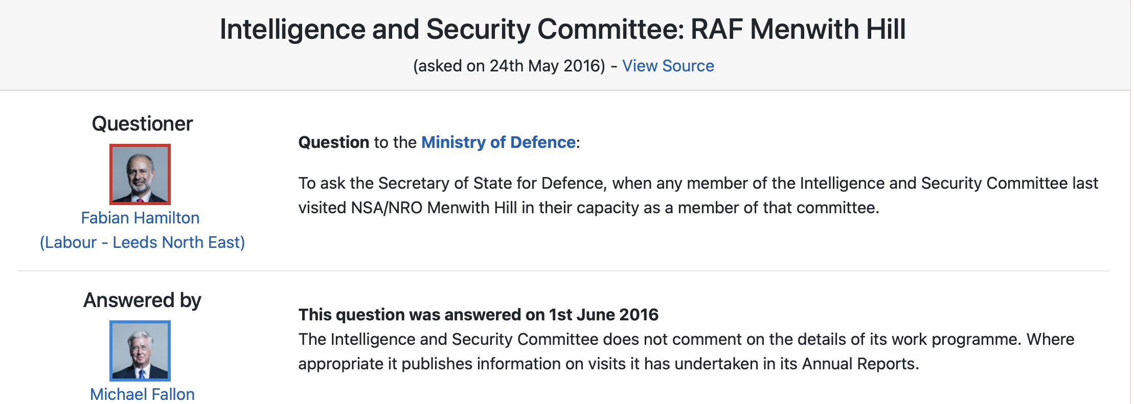

Slide 16
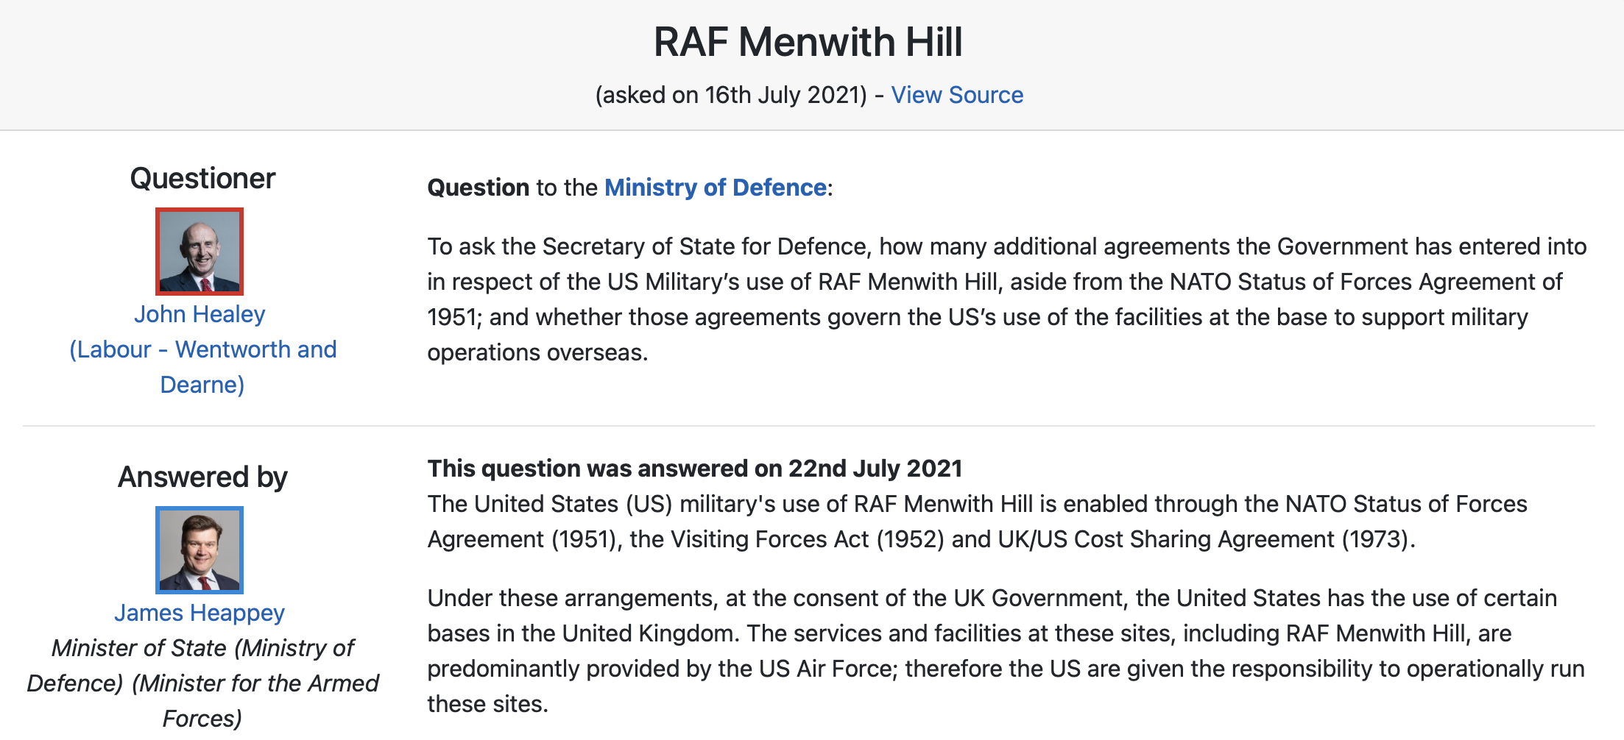

Slide 17
Unaccountable and shielded by secrecy.
Questionable surveillance undertaken using vast amounts of data.
Lethal operations facilitated by Menwith Hill have a high ratio of collateral damage.
No person, organisation or country is held to account for the actions of Menwith Hill.

Slide 18
The Menwith Hill Accountability Campaign demands:
That any US military activity carried out at Menwith Hill be carried out in such a way as to make those responsible fully accountable to the UK;
That all US military and security activity in the UK comply with UK and international law;
The cessation of all illegal UK and US military and security activity in the UK.

